Slide 1
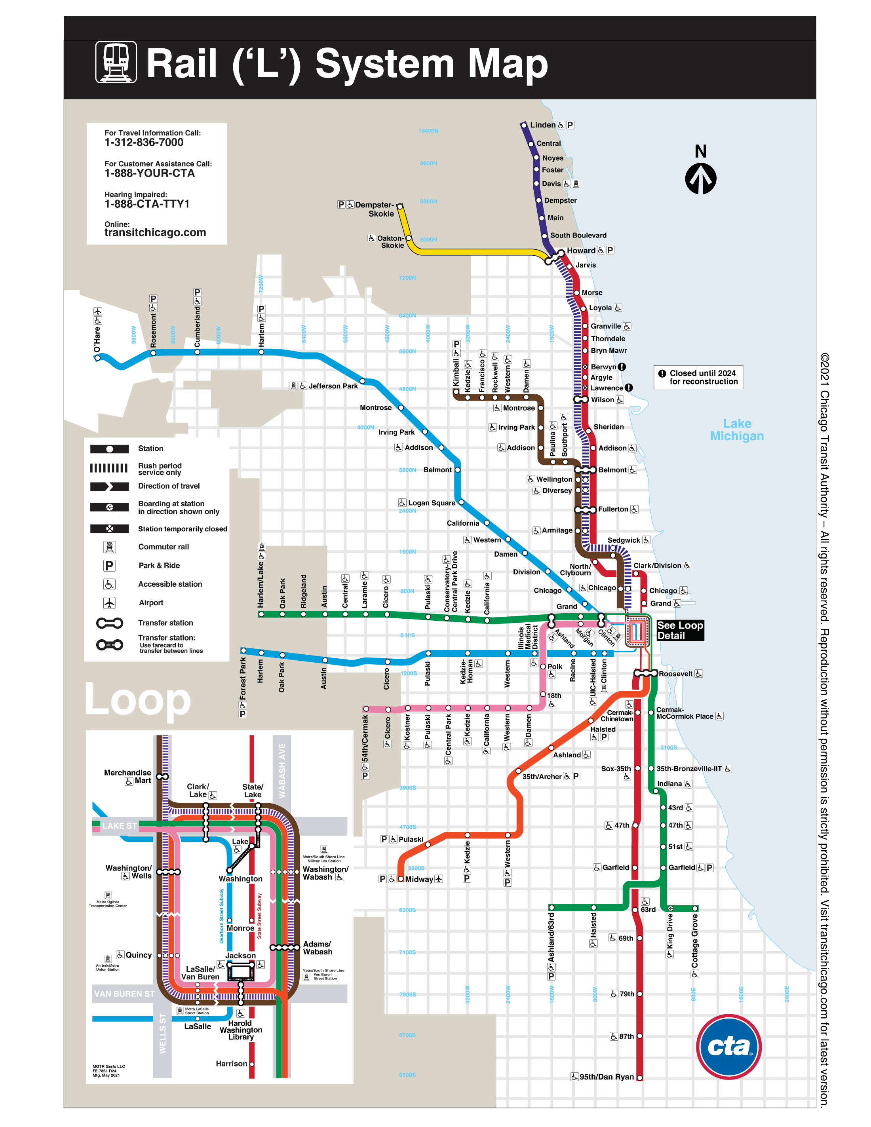
Chicago Transit Authority (CTA) Ridership from 2014-2021: Exploring the impact of COVID-19
Sleep Deprived Parents: Tim Brackett, Roudy Boursiquot, Arielle Bell (Eagan)
Project 1
August 14, 2021

Slide 2
Motivation

Slide 3
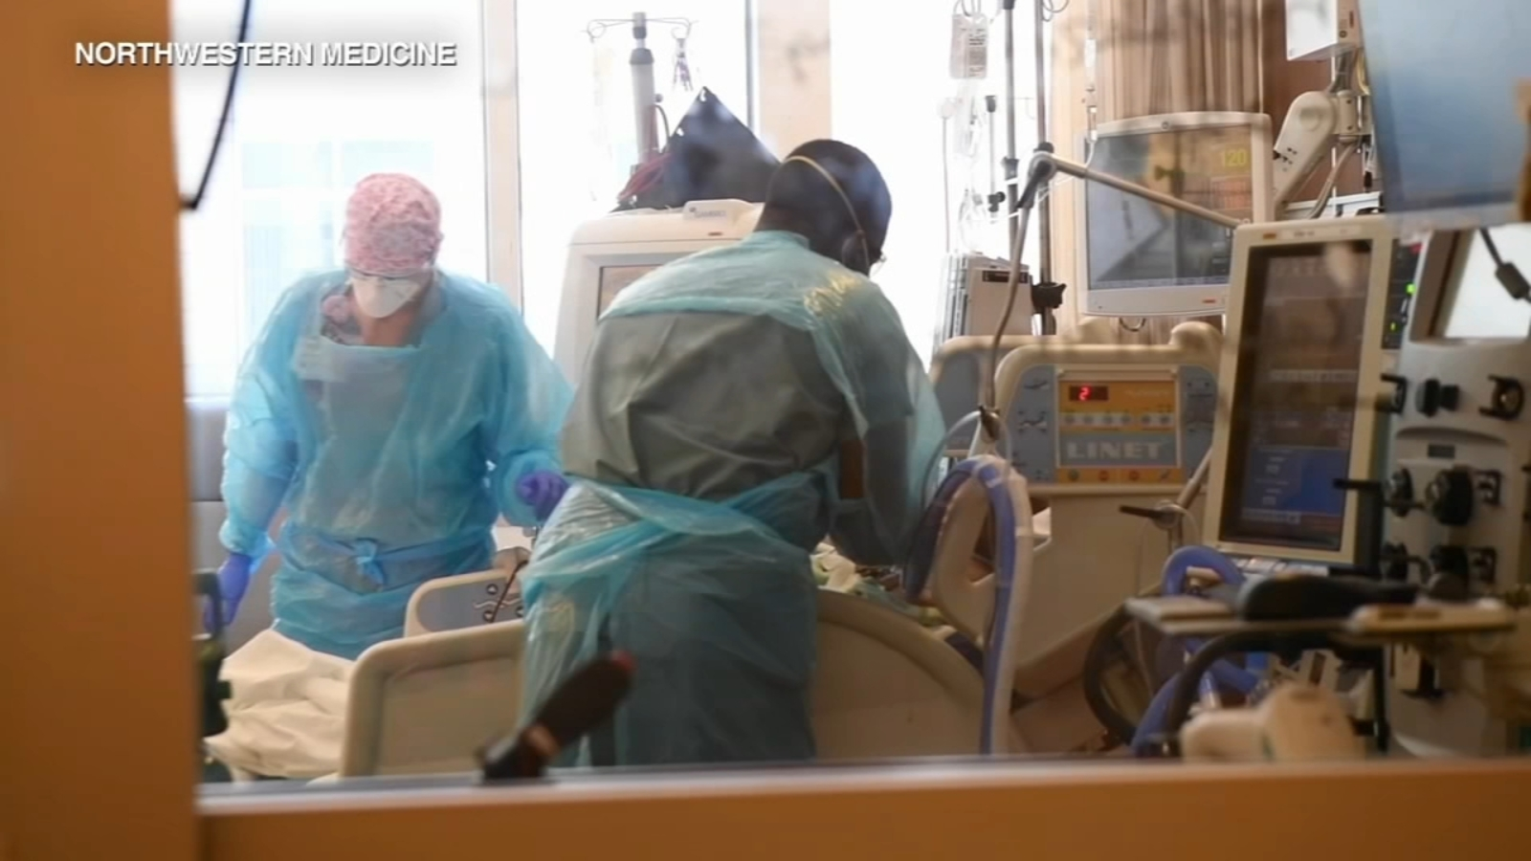
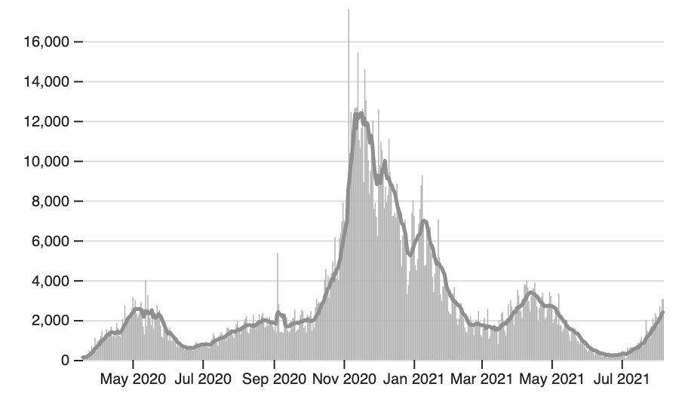
Since March 2020, COVID-19 cases have continued in Illinois
COVID-19 Cases in Illinois March 2020-August 2021
This is the number of new infections discovered daily by diagnostic testing, as reported by the Illinois Department of Public Health
https://illinoiscovid.org/

Slide 4

The Illinois Department of Public Health put mitigations into place to slow the spread of COVID-19.

Slide 5
Our question:
How did COVID-19, and its accompanying mitigations, impact how people used the rail (“L”) system for transportation in 2020?

Slide 6
Null hypothesis:
There was no impact in usage of the rail (“L”) system for transportation in 2020.
Alternative hypothesis:
There was an impact in usage of the rail (“L”) system for transportation in 2020.

Slide 7
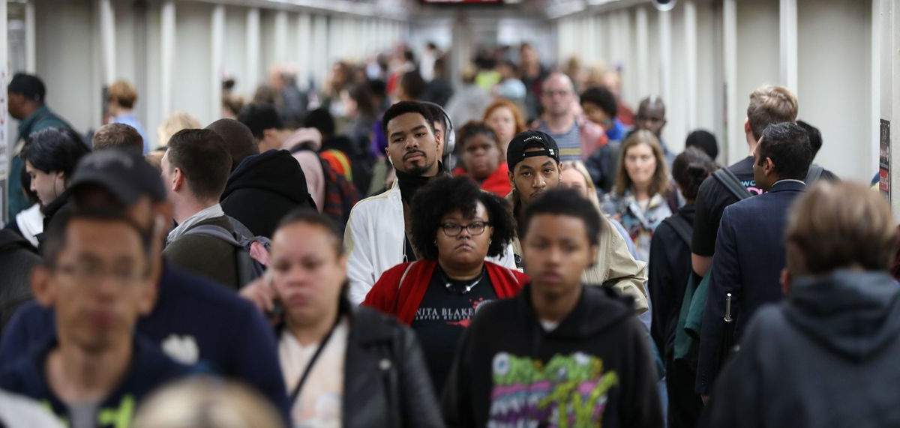
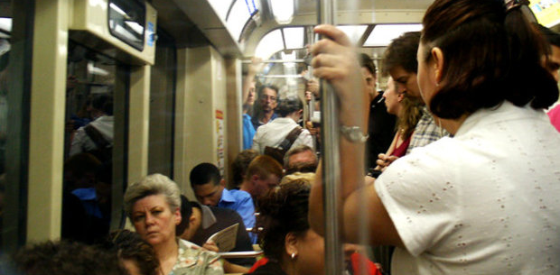
Summary
Our project is to explore and analyze the use of the L via City of Chicago Transit Authority from Jan 1, 2014 to May 31, 2021, with particular interest in seeing any impact of COVID19 on use during 2020 and 2021.
Plan: Use 2014-2019 as a pre-COVID control group, 2020 as our year of COVID-impact, and 2021 to see how trends of use have shifted as vaccination has been available.
Notes:
https://www.dnainfo.com/chicago/20150728/west-loop/your-rush-hour-cta-commute-could-be-getting-more-crowded/
https://www.chicagotribune.com/news/breaking/ct-biz-metra-cta-van-dyke-verdict-20181005-story.html

Slide 8
Questions & Data
Our questions, the data we needed to answer them, and where we found this data

Slide 9
Questions for our data
How has “L” ridership changed between 2014 to 2020?
Between 2014 and 2020, what “L” lines had the highest ridership? What stations on those lines had the highest ridership?
Between 2014 and 2020, was there a seasonal component to “L” ridership?
How was CTA “L” ridership impacted in 2020? Has it rebounded so far in 2021?
Notes:
In order to understand the potential impact of COVID-19 and its mitigations on L ridership in 2020 and 2021, we first had to understand what “normal” ridership looks like. This includes understanding historical trends, the range of usage across lines and stations, and seasonal components of usage. Thus, we began with 3 questions to create a “baseline” understanding of ridership. Our 4th question would then investigate our central question and hypothesis.

Slide 10
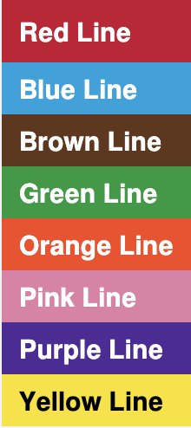
Data needed: “L” usage

Slide 11

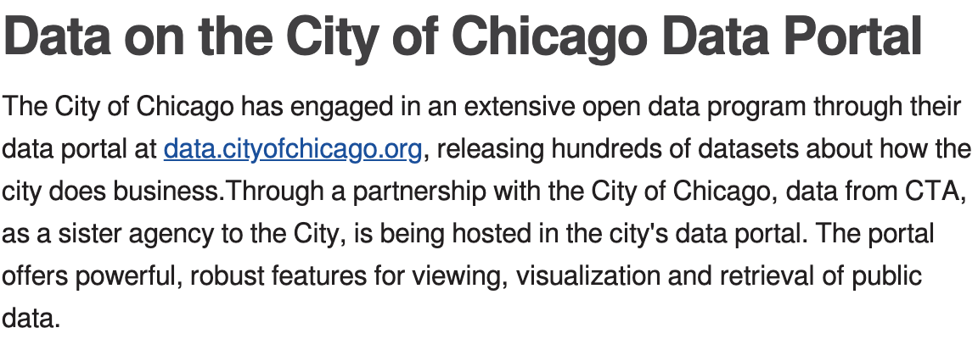
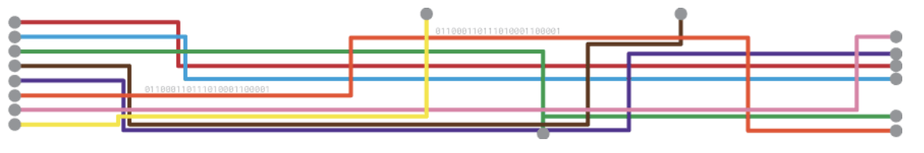
Data source: City of Chicago Data Portal
URL:
https://data.cityofchicago.org/

Slide 12
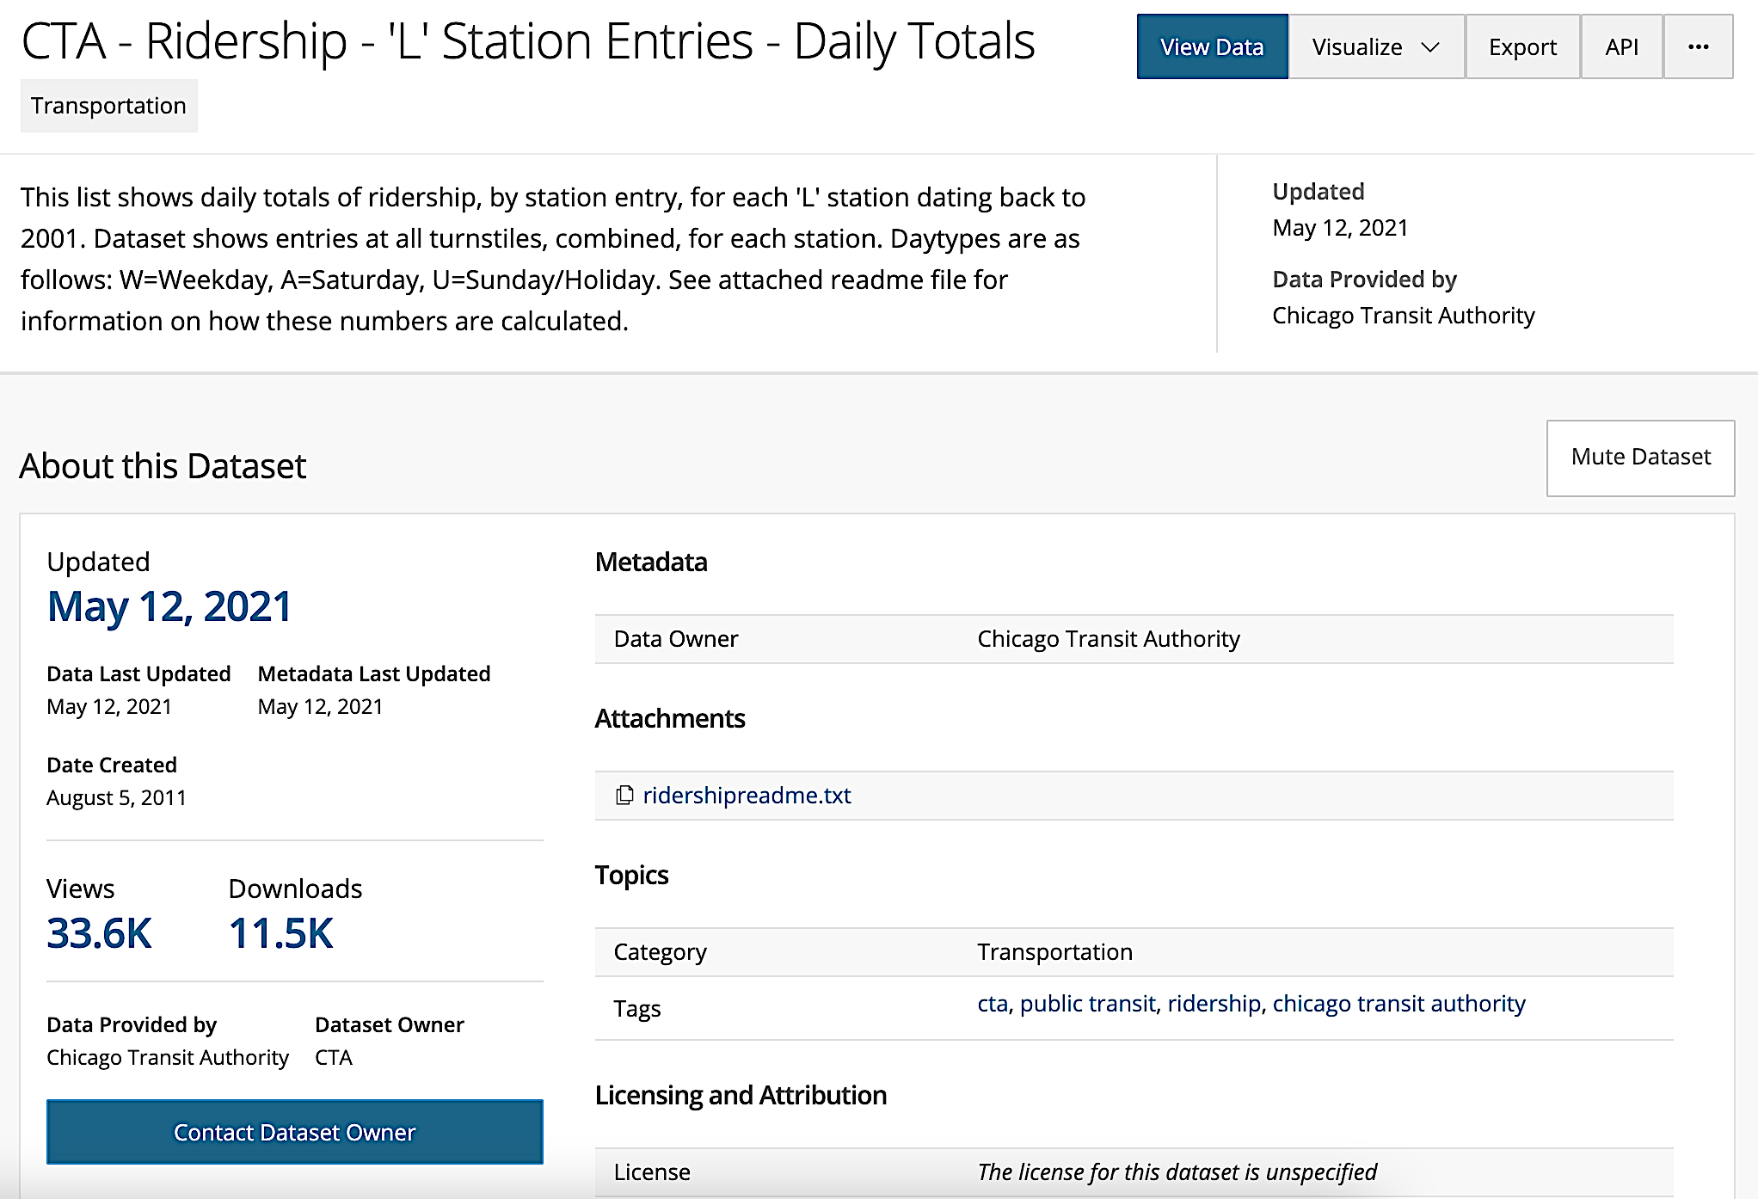
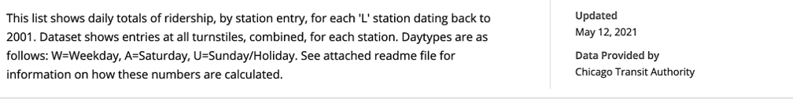
Dataset: CTA-Ridership- ‘L’ Station Entries – Daily Totals

Slide 13
Analytic process
How we explored, cleaned, and analyzed the data to answer each of our four questions

Slide 14
Overall data exploration and clean-up
Insights:
We reviewed the data to understand how it was organized. The dataset was quite large and had great depth (ex: type of day, line colors intersecting at stations, etc.)
Problems:
Though updated to May 12, 2021, data ended at Feb 28, 2021. This meant that we could not analyze 2021 fully. Therefore, we adapted our 4th question:
Original: How was CTA “L” ridership impacted in 2020? Has it rebounded so far in 2021?
New: How was CTA “L” ridership impacted in 2020?
We realized that “L” stations and color lines were grouped together, and multiple line colors overlapped. We could see if a person paid at a station, but not which line they decided to take from there.

Slide 15
Question #1
How has “L” ridership changed between 2014 to 2020?
Between 2014 and 2020, what “L” lines had the highest ridership? What stations on those lines had the highest ridership?
Between 2014 and 2020, was there a seasonal component to “L” ridership?
How was CTA “L” ridership impacted in 2020?
Notes:
Now let’s discuss how we explored, cleaned, and analyzed the data according to each question.

Slide 16
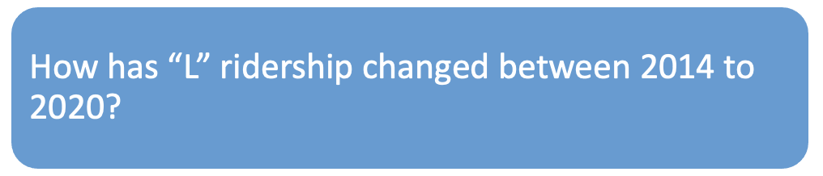
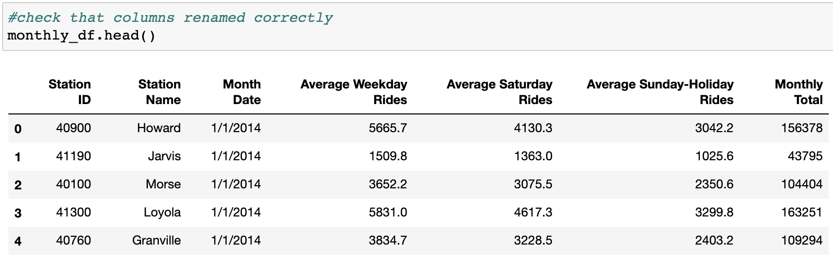
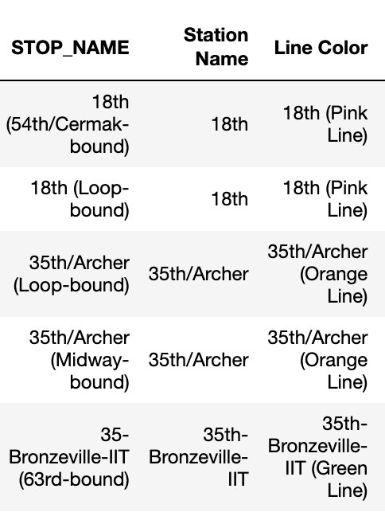
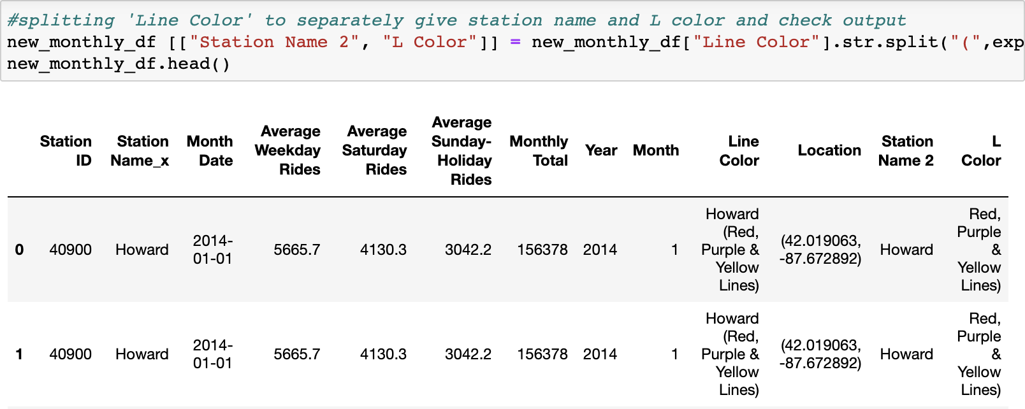
Exploration:
Insights:
We decided to focus on monthly usage across the years.
Problems:
Station vs L color issue
Clean-up:
Overlapping datapoints
Station and multiple L colors
Month and year
Needed to combine monthly totals, then review across years
Plot formatting due to length of station and line color names
We tried seaborn, dexplot, eventually figured out to cut down lables and rotate x ticks

Slide 17
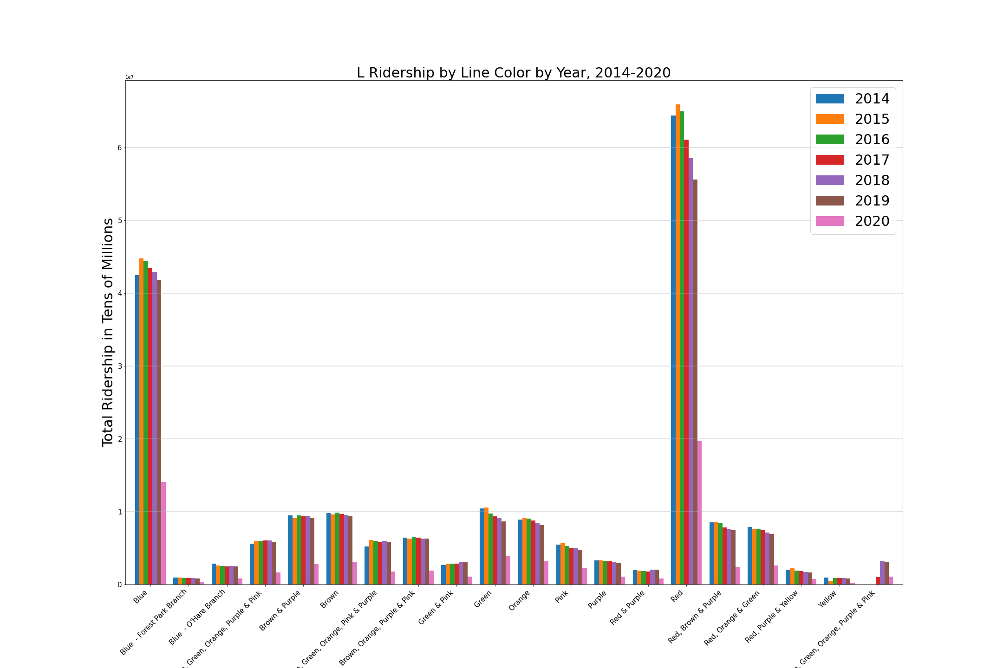
Analysis:
Blue and Red lines had substantially higher usage across all years, compared to other L colors
Both the Blue and Red lines seem to have decreased from 2015 to 2019. We are not sure why.
A substantial drop was seen in 2020 in all L colors, with drastic drops on the Blue and Red lines.

Slide 18
Question #2
How has “L” ridership changed between 2014 to 2020?
Between 2014 and 2020, what “L” lines had the highest ridership? What stations on those lines had the highest ridership?
Between 2014 and 2020, was there a seasonal component to “L” ridership?
How was CTA “L” ridership impacted in 2020?

Slide 19
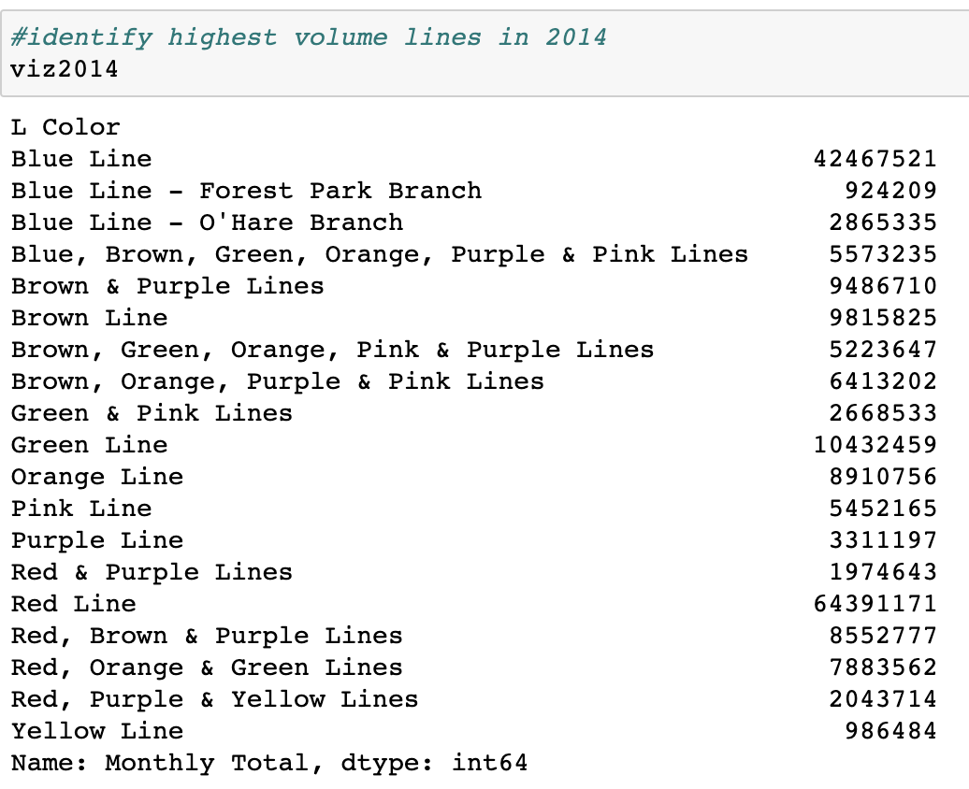
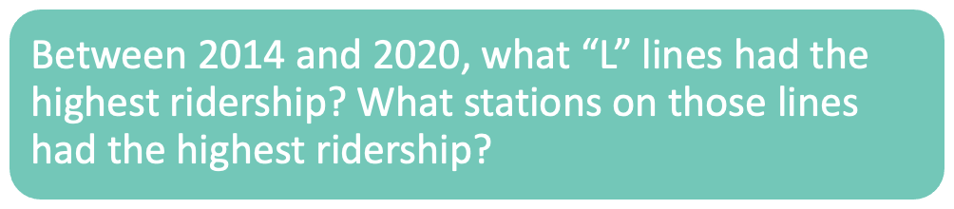
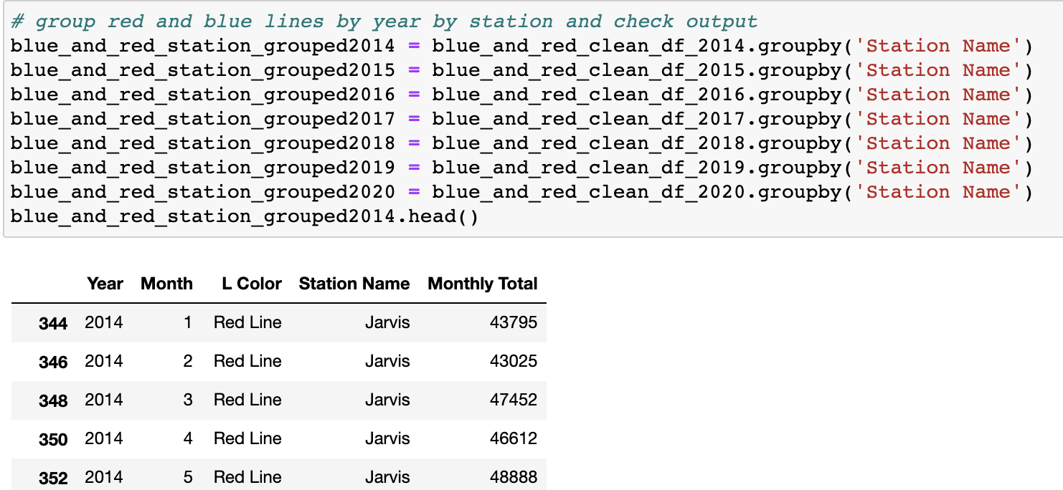
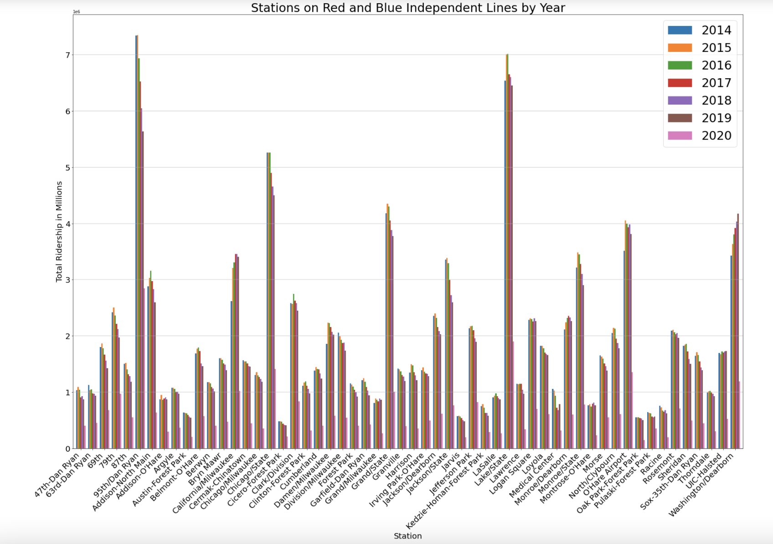
Exploration:
First, we had to determine the L lines with the highest ridership:
Used findings of Question 1 (How has “L” ridership changed between 2014 to 2020?) to identify the L lines that had the highest ridership for each year. Selected Blue Line and Red Line, as they had most consistently highest usage over 2014-2020.
Issue:
We were not able to consider Blue and Red if it overlapped with other colors, thus biasing our data
We decided to focus on station usage
Clean-up:
Groupings
Had to group by Blue and Red, then by station, then by year, then by monthly total
Space issues when plotting
Had to limit to top 5 busiest stations on Blue and Red line in order to fit onto a plot in a legible way

Slide 20
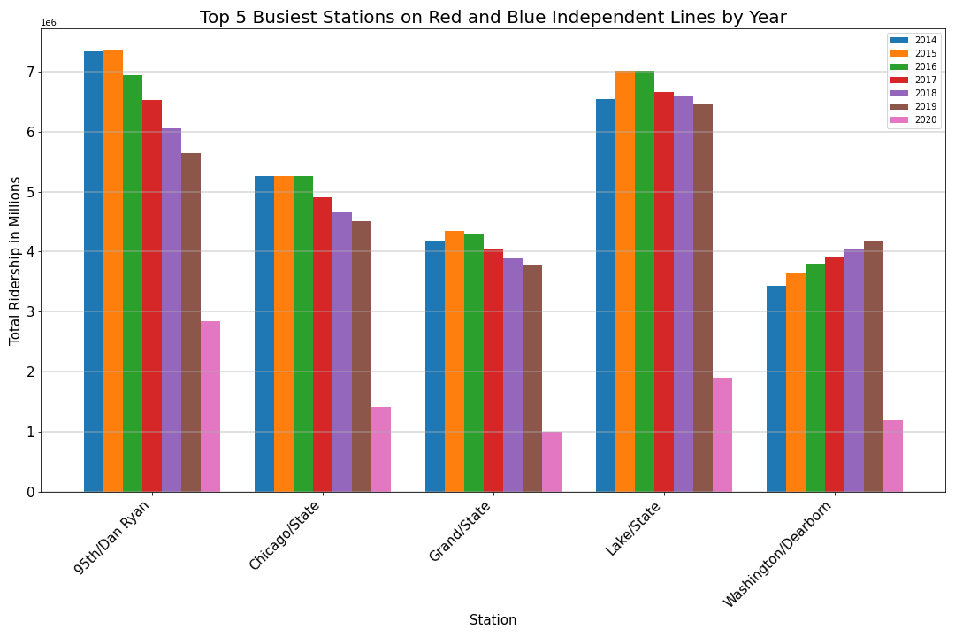
Analysis:
On the Red and Blue independent lines, these 5 stations had the most use between 2014 and 2020.
Between 2014-2015, stations stayed almost the same in usage or increased slightly in usage.
Between 2016-2020, four of the five stations decreased. For some reason, Washington/Dearborn increased steadily between 2014 and 2019, unlike the others.
All stations saw a substantial decrease in 2020.

Slide 21
Question #3
How has “L” ridership changed between 2014 to 2020?
Between 2014 and 2020, what “L” lines had the highest ridership? What stations on those lines had the highest ridership?
Between 2014 and 2020, was there a seasonal component to “L” ridership?
How was CTA “L” ridership impacted in 2020?

Slide 22
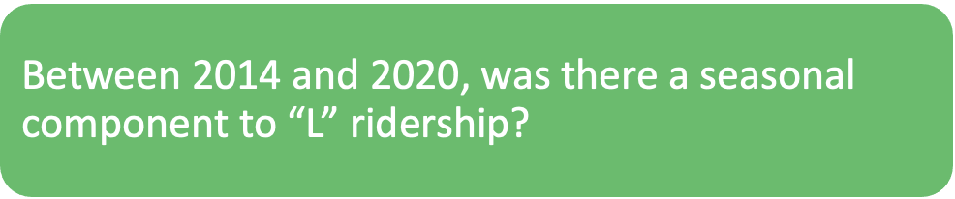
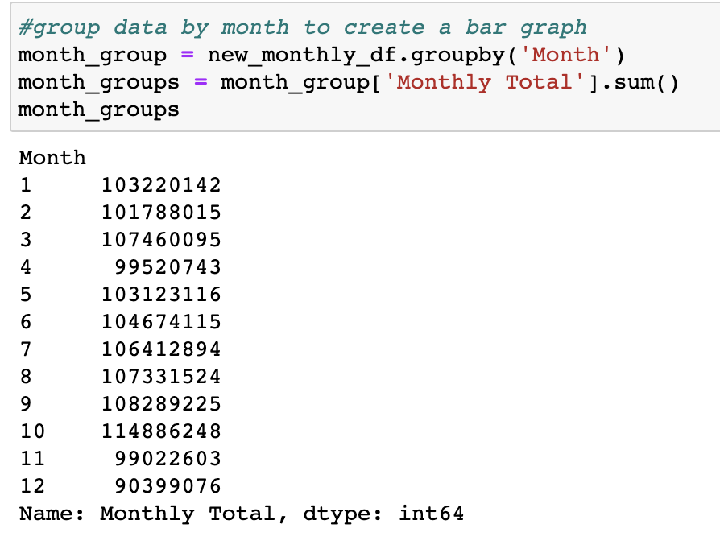
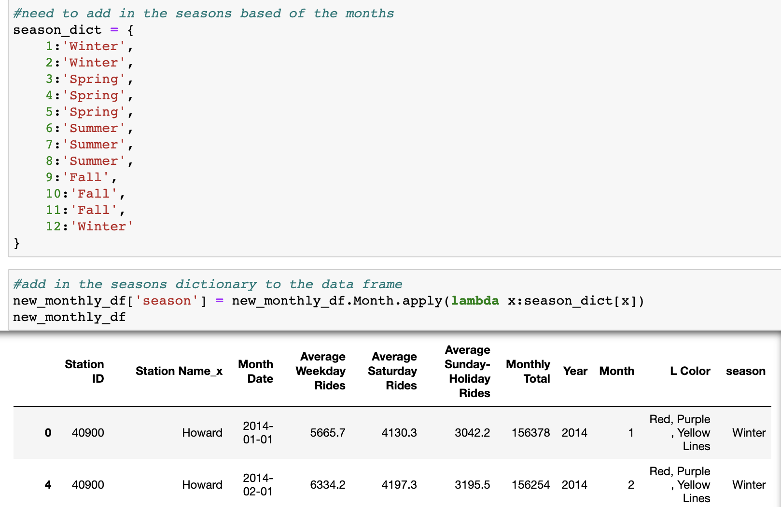
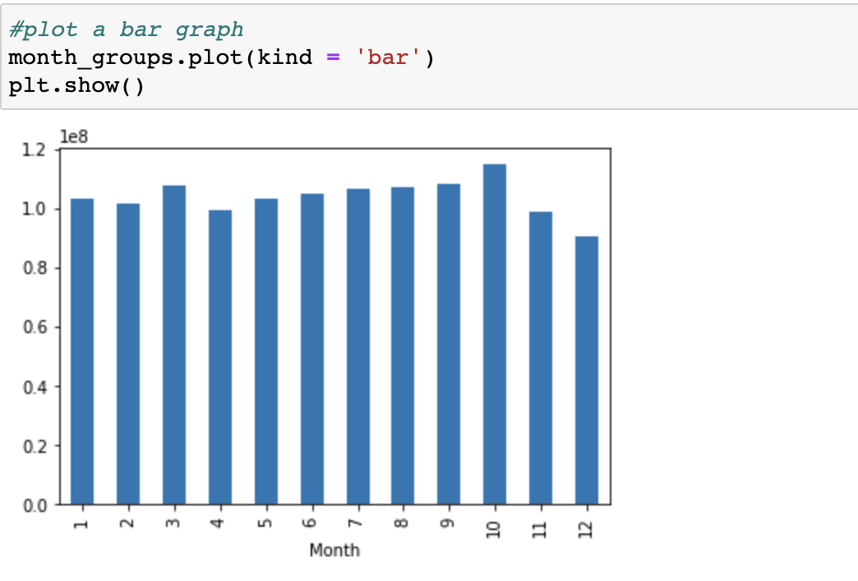
Exploration:
In order to explore the seasonal ridership, we had to figure out the total ridership per month for all 7 years
Once we figured out the ridership, we had to think through on how to add in the four seasons in our data column
Clean-up:
Add in a column for seasons
Created a dictionary to match seasons to each of the twelve months, and write in a formula
Created a bar graph
Plotting a bar graph by the twelve months helped us ensure that the data was reflective of the bar graph with the four

Slide 23
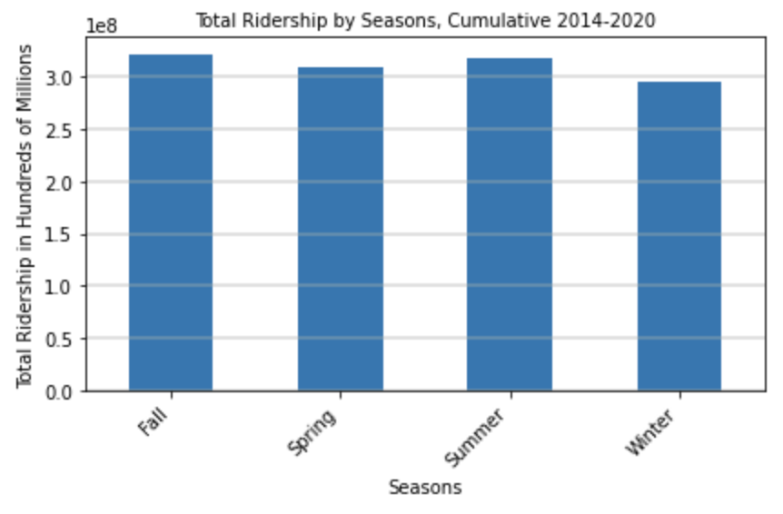
Analysis:
Between 2014 – 2020, there’s certainly a slight seasonal component to L Ridership
Winter Season – 295M
Spring Season – 310M
Summer Season – 318M
Fall Season – 322M
Winter season is the only one that didn’t reach more than 300M riders which can be attributed to the two major holidays and colder temperatures
In contrast to the winter, the fall season boasted the highest number of total monthly riders between 2014 - 2020

Slide 24
Question #4
How has “L” ridership changed between 2014 to 2020?
Between 2014 and 2020, what “L” lines had the highest ridership? What stations on those lines had the highest ridership?
Between 2014 and 2020, was there a seasonal component to “L” ridership?
How was CTA “L” ridership impacted in 2020?

Slide 25

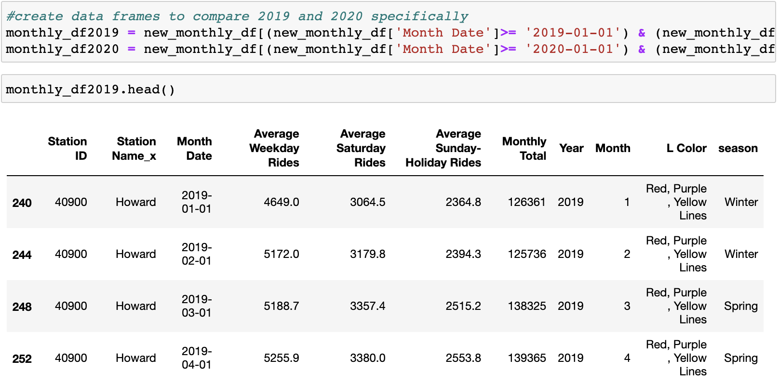
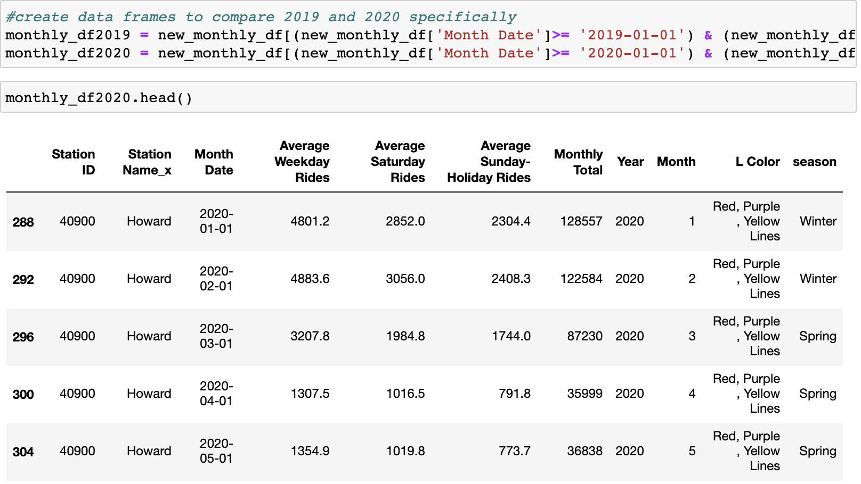
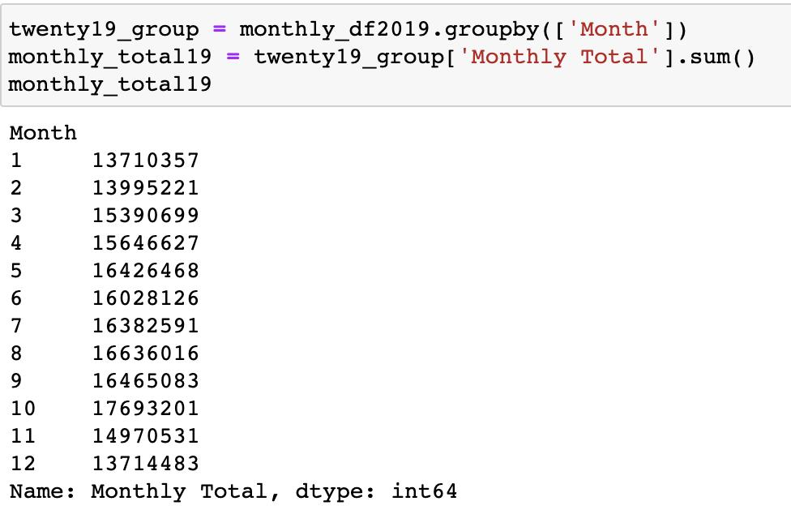
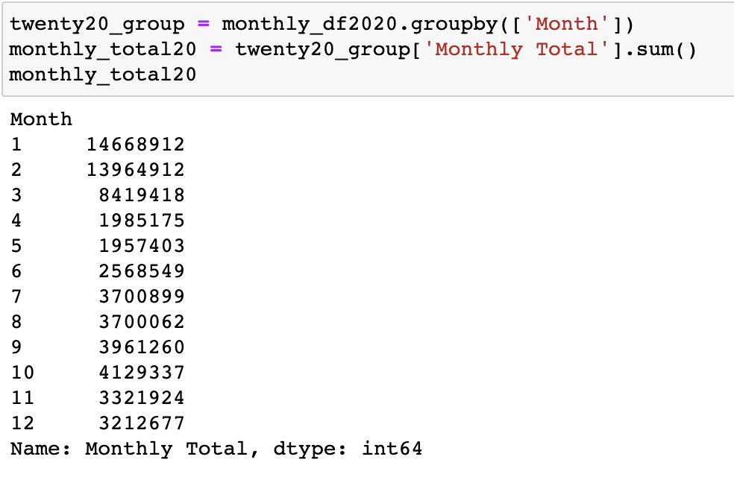
Exploration:
Timeframe
In order to determine L ridership impact in 2020, we decided to compare monthly ridership for 2019 data with 2020 monthly ridership data
Limits of data
We also wanted to compare to 2021 to measure how ridership had rebounded since the start of the COVID pandemic, but unfortunately, there was limited 2021 data
Clean-up:
Data type
Transformed the date data type from object to datetime
Use of dataframes
Timeframes Isolated 2019 and 2020 data into two separate new dataframes
Once the two separate dataframes were created, we grouped the 2 dataframes by month and then created a line graph with the monthly totals

Slide 26
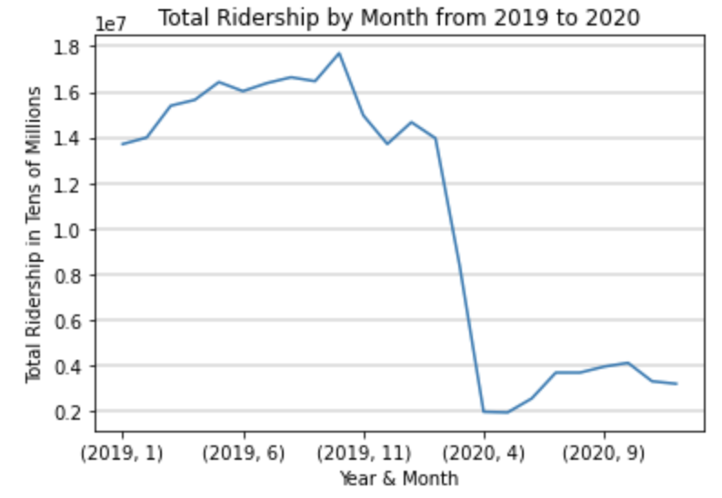
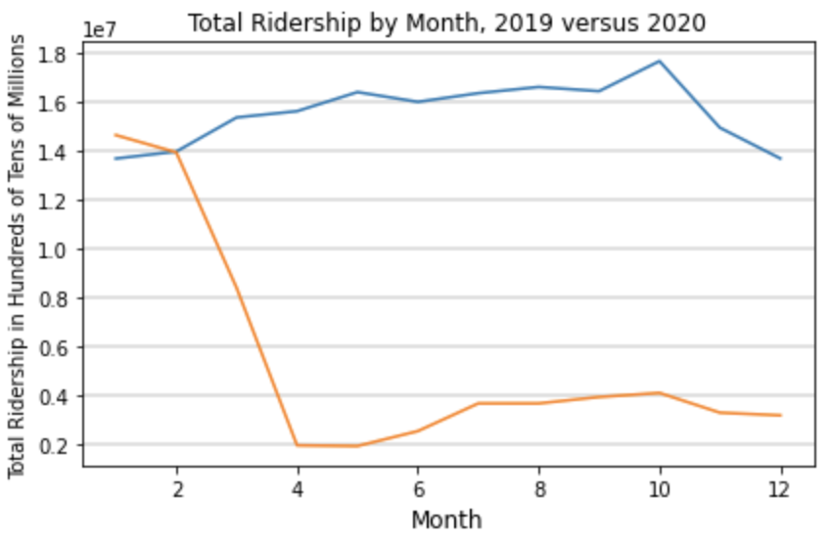
Analysis:
As anticipated, there was a significant drop in total monthly ridership in April 2020, which coincided with COVID lockdowns from end of March 2020 to May 2020
Ridership suffered major impact likely due to office and school closings, reducing passengers in close proximity on trains, ect.
Since the beginning of the summer 2020 (months 5-8), ridership was steadily increasing up until the second COVID spike in Illinois at the beginning of the 2020 winter
2019
2020

Slide 27
Discussion

Slide 28
Discussion
Hypothesis:
Overall, we saw an impact in usage in 2020 so we reject our null hypothesis that ridership did not change and accept our alternative hypothesis that there was an impact.
However, though we can say that this is correlated with COVID-19, further research is needed to say that this relationship is casual.
Despite the dataset being updated in May 2021, the data available only went to February 2021. If we had explored 2021, we believe we may have seen an increase as COVID-19 mitigations relaxed throughout Chicago and people returned to everyday activities.
For our analysis, we can conclude 4 main findings:
Ridership decreased from 2014-2019, perhaps due to alternative means of transportation such as Uber/Lyft. More research here is needed to understand these trends.
The Blue and Red lines, and their associated 95th/Dan Ryan and Lake/State Stations, consistently see the highest usage.
On average, Fall and Summer have the highest ridership, followed by Spring and then Winter with slightly lower use.
Ridership was impacted in April 2020. Though it slightly increased in the following months, remained low until the end of 2020.

Slide 29
Reflection & Future Steps

Slide 30
Reflection & Future Steps
Reflection:
We navigated the limits of the dataset by adapting our research questions. This reminds us that research is an iterative process and revisions may be necessary in order to use the data well.
We learned to collaborate and merge our code, which is important to practice for future team-based work.
Future Steps:
If we were to conduct this research in 2022, we could have the full Jan-Dec 2021 data available. With this, we could explore our original question of if/how ridership has rebounded in 2021.
With 2021 data, we could also consider if/how rebounding ridership numbers may be correlated with geographic vaccination data, which the state has by zip code. We could compare the ridership at the stations we analyzed with the socioeconomics within these zip codes. These two steps could help us explore possible correlations between vaccination, ridership, and community socioeconomics to investigate possible reasons for why certain stations may rebound in ridership faster than others.

Slide 31

Questions?

